Slide 1
Standard Template Library STL

Slide 2
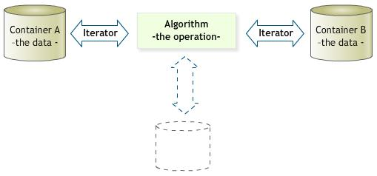
Standard Template Library
Three basic components of STL are:
containers
iterator
algorithm

Slide 3
STL
Containers
container are template classes for data storage
many types of containers exist
e.g., list for link list, vector for arrays and many more
Iterators
Iterators are pointers of STL
They are used to point to the individual data items in the container for reading or writing
Algorithms
to be discussed later on

Slide 4
list container and iterator
list<int> intlist;
list<int>::iterator intlistitr;
Iterators can be initialized using list functions
intlistitr = intlist.begin();
now the iterator point to the first element of the list
intlistitr++
it will take the pointer to the next object
*intlistitr
dereferencing the pointer to access the data

Slide 5
Useful list member functions
push_back(data);
inserts data at the end
push_front(data);
inserts data at the front
sort()
sort the link list nodes
unique()
delete the duplicate values

Slide 6
Example
list<int> int_list;
int_list.push_back(1);
int_list.push_back(1);
int_list.push_back(8);
int_list.push_back(9);
int_list.push_back(7);
int_list.push_back(8);
int_list.push_back(2);
int_list.push_back(3);
int_list.push_back(3);
// 1 1 8 9 7 8 2 3 3
int_list.sort(); // 1 1 2 3 3 7 8 8 9
int_list.unique(); // 1 2 3 7 8 9
list<int>::iterator list_iter;
for(list_iter = int_list.begin(); list_iter != int_list.end(); list_iter++)
cout<<*list_iter<<endl;

Slide 7
list
size()
returns the number of items in the list
front()
returns the first element
pop_front()
deletes the first element

Slide 8
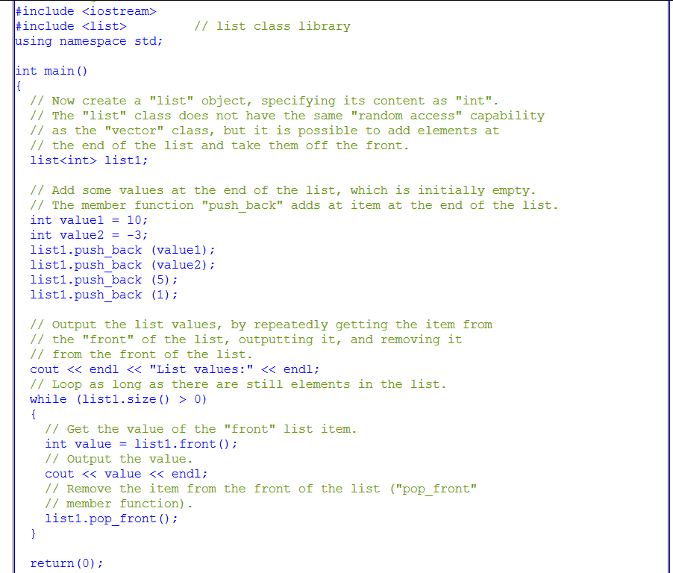
Example

Slide 9


list functions
insert(position, value);
erase(position)

Slide 10
STL list

Slide 12
ct and ct1 are list object

Slide 13
TABLE 5-10 Operations specific to a list

Slide 14
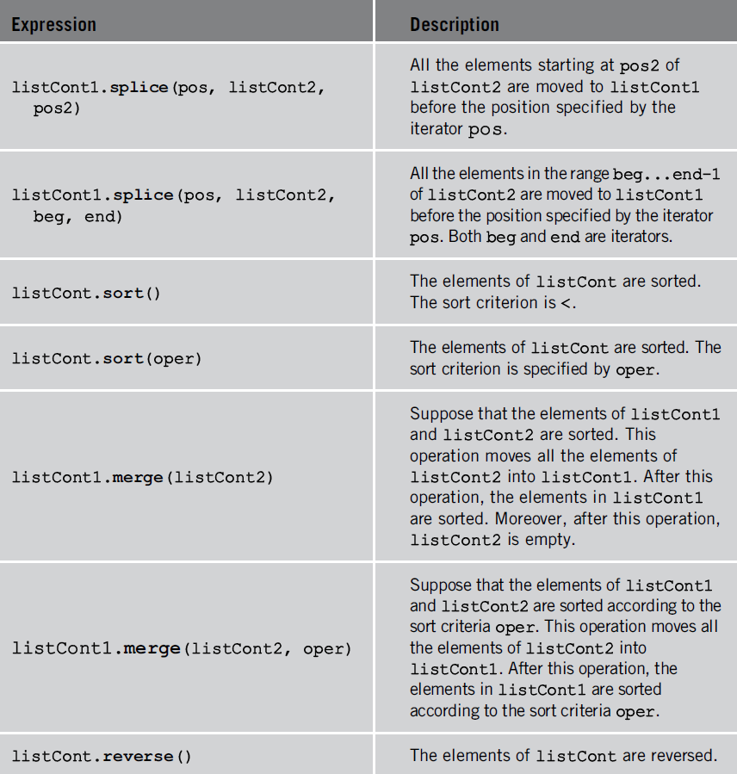
TABLE 5-10 Operations specific to a list (cont’d.)

Slide 15
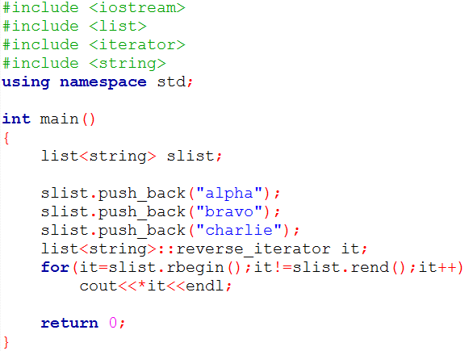
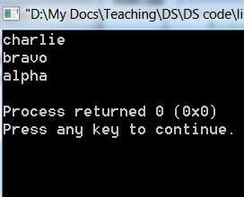
Reverse iterator

Slide 16
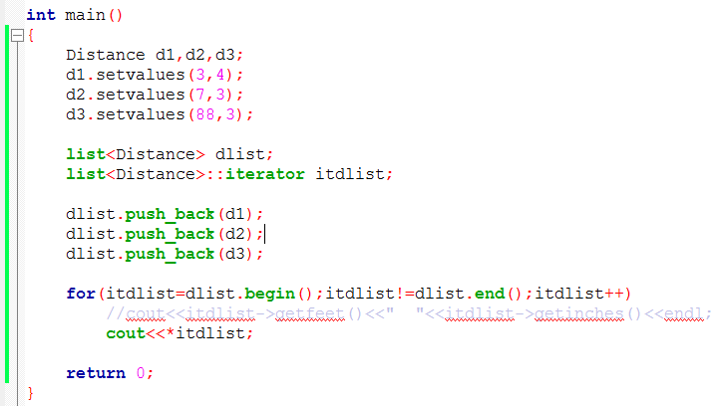
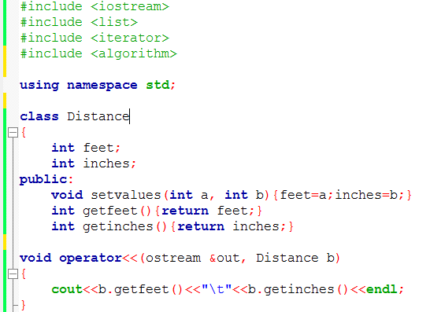

Slide 17
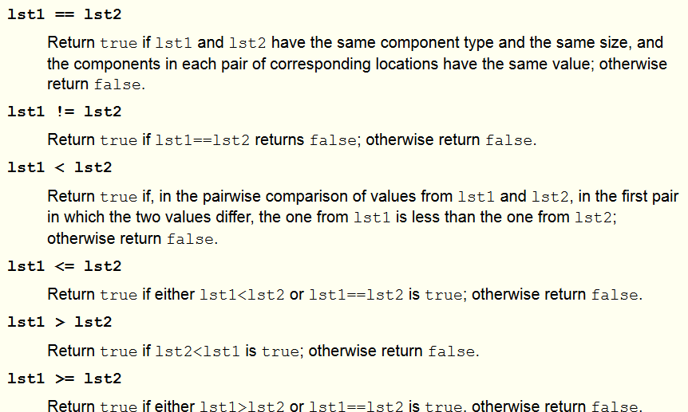
Relational Operator overloaded

Slide 18
STL stack
STL also provides stack class.
#include <stack>
Operations supported are
size()
empty()
push(item)
top()
pop()

Slide 19
STL queue

Slide 20
#include <queue>

Slide 22
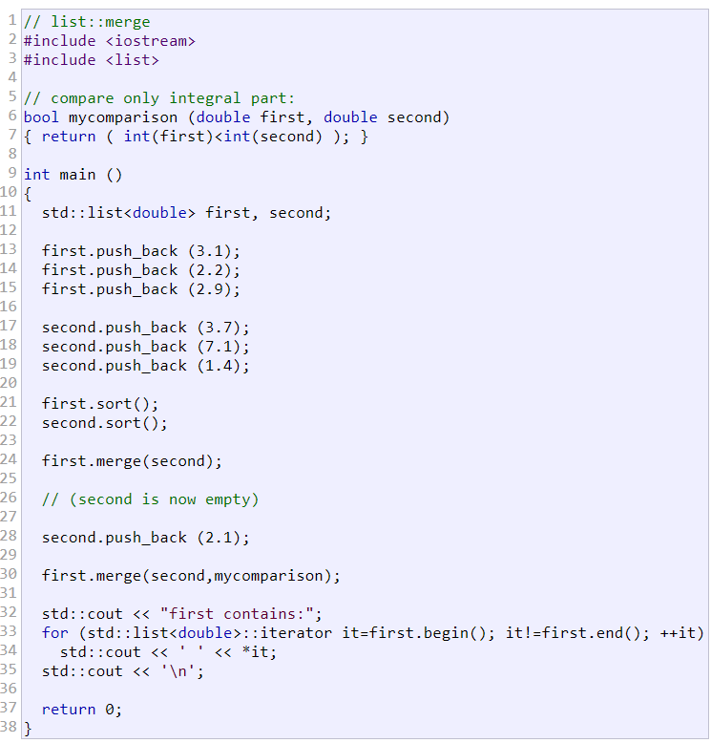

merge()

Slide 23
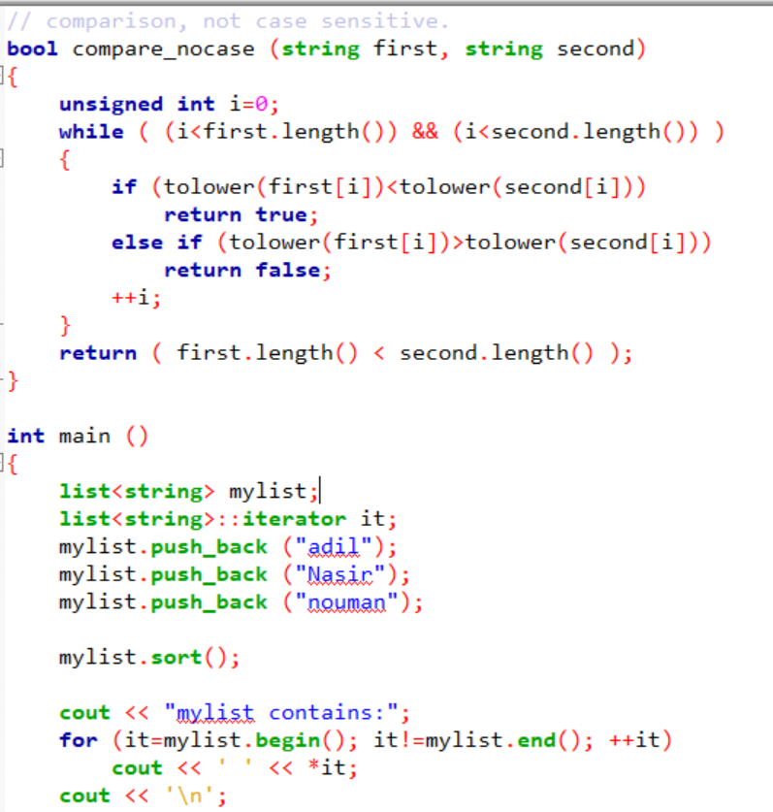
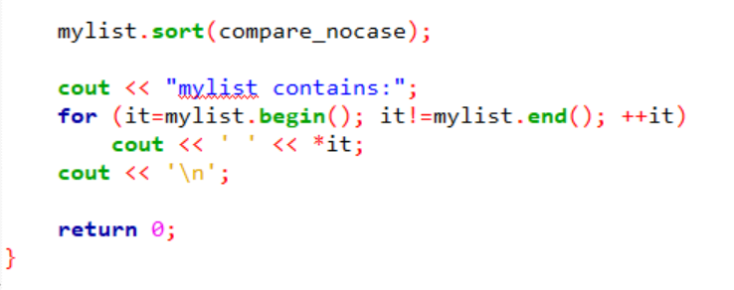
sort()

Slide 24
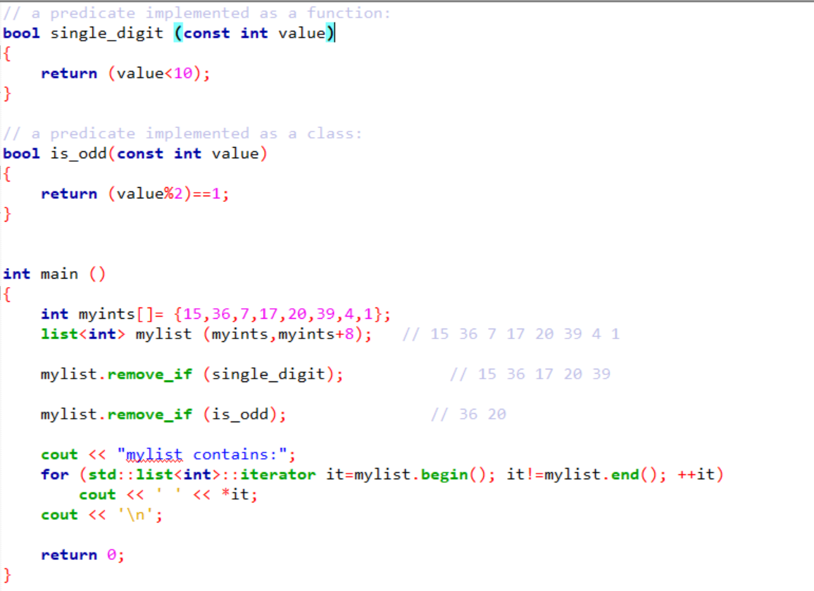
remove_if( )

